Slide 1

Beyond the Clouds, The Discovery Initiative
Credits: NASA
How Should Next Generation Utility Computing Infrastructures Be Designed to Solve Sustainability & Efficiency Challenges ?
Adrien Lebre
March, 2015 - RENATER - GEANT Association
Notes:
L’idée de depart: est ce que le cloud computing est LE modele d’UC abouti.
3 parties : Pourquoi il est necessaire de proposer une architecture d’UC nouvelle
Zoom sur la gestion dynamique des VMs dans ce nouveau cloud

Slide 2
Localization is a key element to deliver efficient as well as sustainable Utility Computing solutions
A simple Idea
Bring Clouds back to the cloud

Slide 3


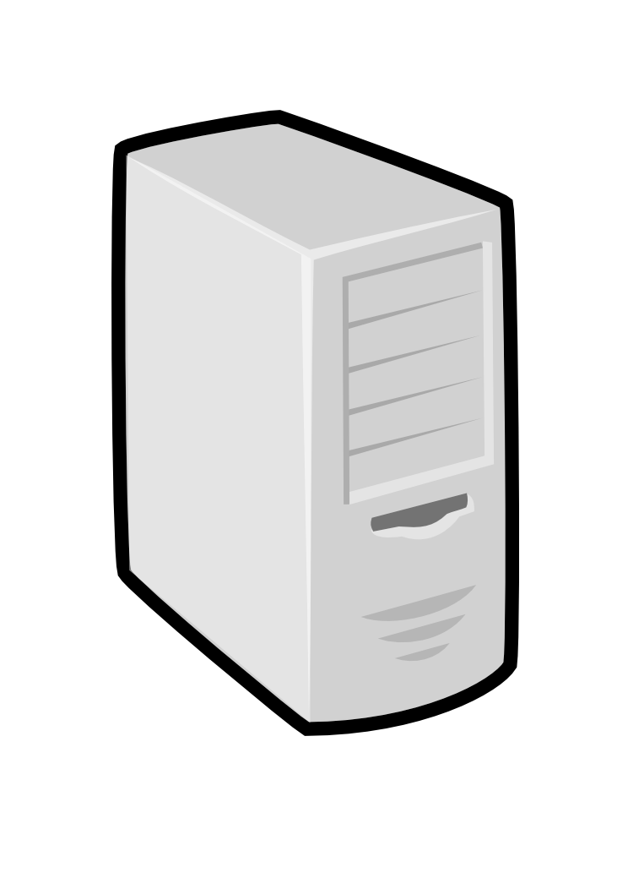

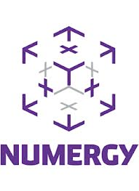



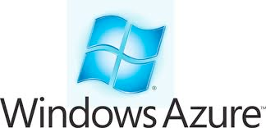

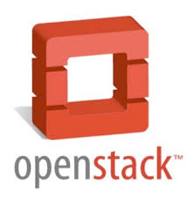
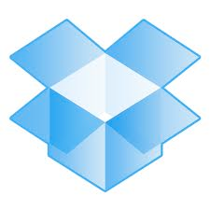
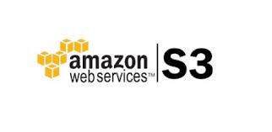

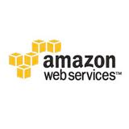


The cloud from end-users
Bob
Dan
Alice
Charles
Duke
Sam
-
Paula
Users’ energy footprint
Rob

Slide 4
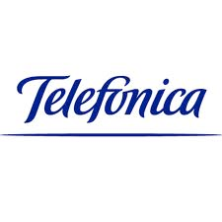





The cloud in reality
Bob
Dan
Alice
Charles
Duke
Internet
backbone
Sam
Paula
Users’ energy footprint
Rob

Slide 5
The Discovery Initiative
Bob
Dan
DISCOVERY Network
Alice
Charles
DISCOVERY Network
DISCOVERY Network
DISCOVERY Network
DISCOVERY Network
Duke
DISCOVERY Network
DISCOVERY Network
DISCOVERY Network
DISCOVERY Network
Sam
-
Paula
-
Users’ energy footprint
Tom
Rob

Slide 6
Why ?
Let’s give a look to the current situation

Slide 7
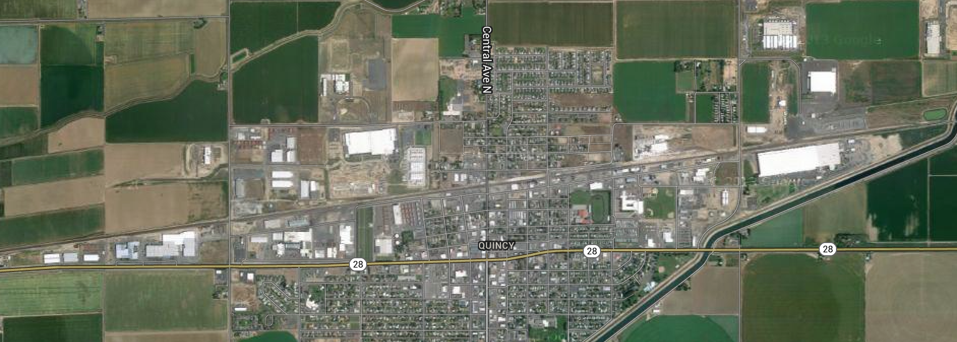
The Current Trend: Large off shore DCs
To cope with the increasing UC demand while handling energy concerns but…
credits: datacentertalk.com - Microsoft DC, Quincy, WA state
credits: google map - Quincy
credits: coloandcloud.com
Notes:
getting data in/out cloud is slow and possibly expensive
The nice idea would be to have micro DCs close to you so you are not impacted so much by the network overheads but deploying new micro DC concepts is expensive and the question where deploying them is also hard ?

Slide 8


Inherent limitations of current solutions
Large off shore DCs to cope with the increasing UC demand while handling energy concerns but…
Charles
Alice
Charles
Bob
Denis
1. Externalization of private applications/data (jurisdiction concerns, PRISM NSA scandal, Patriot Act)
Internet
backbone
2. Overhead implied by the unavoidable use of the Internet to reach distant platforms
3. The connectivity to the application/data cannot be ensured by centralized dedicated centers (disaster recovery)
Hybrid platforms: a promising approach
It depends how you are going to extend the private one...
Can we address these concerns ‘‘all in one’’ ?
µ/nDC concept
Notes:
getting data in/out cloud is slow and possibly expensive
The nice idea would be to have micro DCs close to you so you are not impacted so much by the network overheads but deploying new micro DC concepts is expensive and the question where deploying them is also hard ?

Slide 9
How and where the µDC concept can be deployed ?
Locality Based Utility Computing
Toward LUC Infrastructures

Slide 10
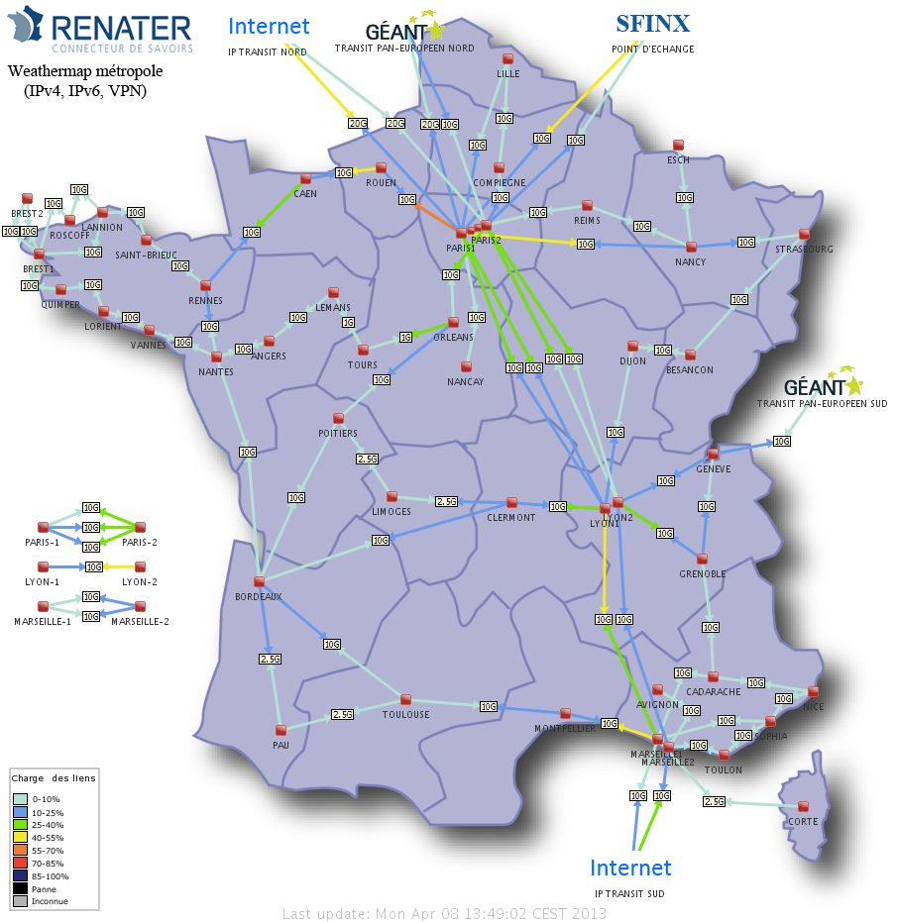
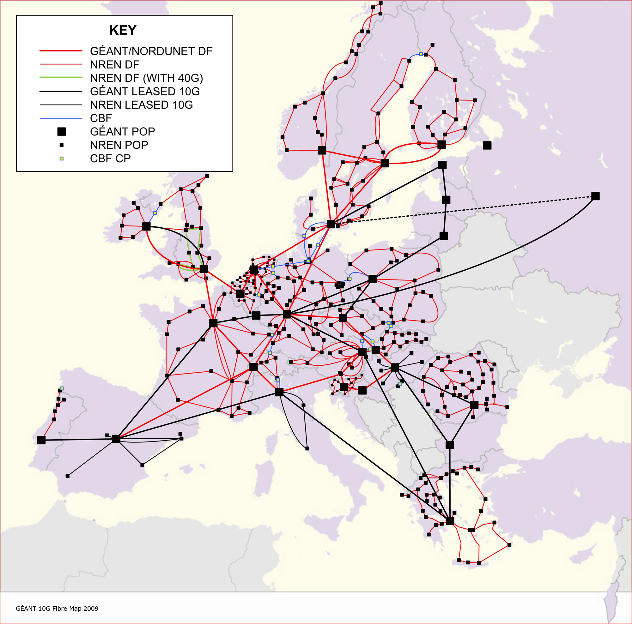
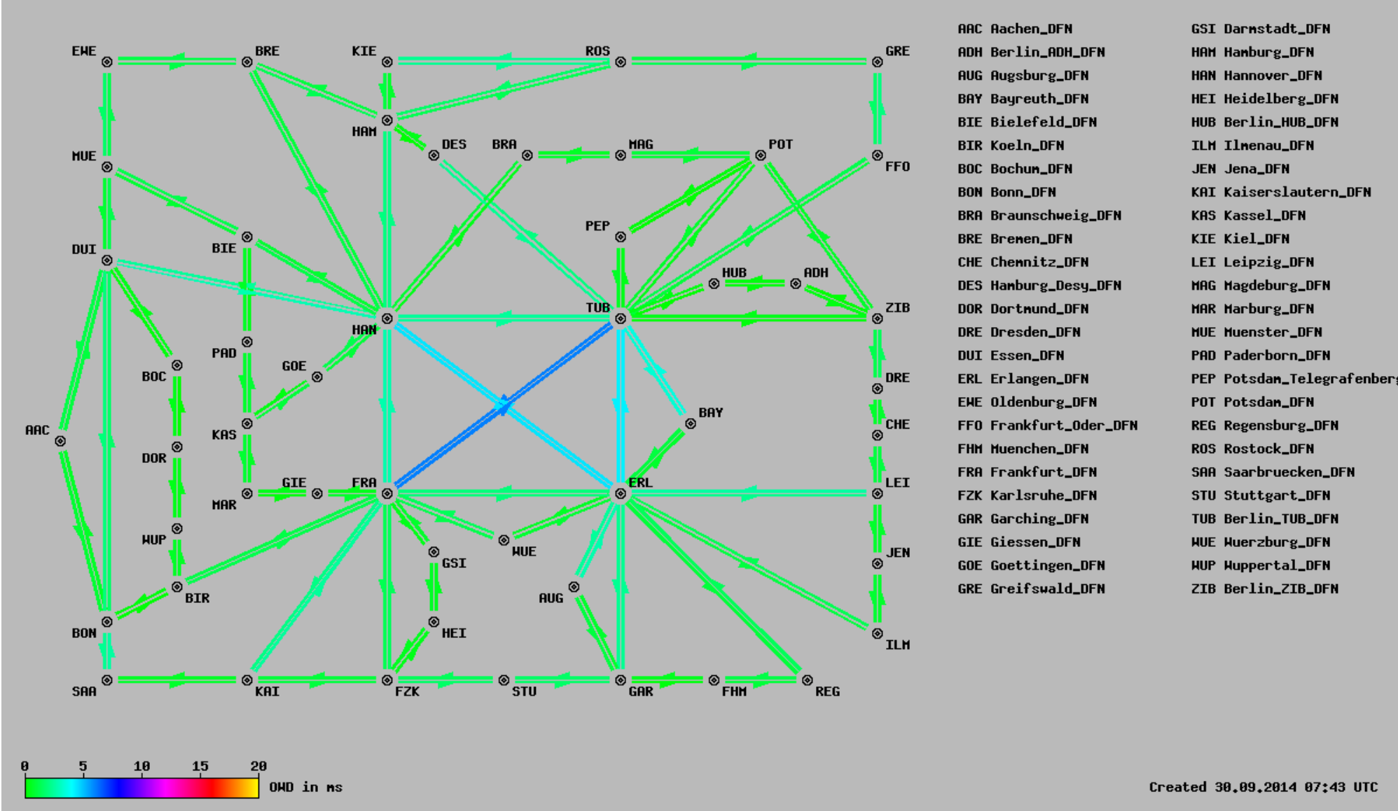
Beyond the Clouds, the DISCOVERY Initiative
Locality-based UC infrastructures A promising way to deliver highly efficient and sustainable UC services is to provide UC platforms as close as possible to the end-users.
http://www.renater.fr/raccourci?lang=fr
X-Win - German NREN More than 50 PoPs !
http://www.win-labor.dfn.de/cgi-bin/hades/map.pl?config=win
Notes:
UC platforms should be tightly coupled with any facilities available through the Internet, starting from the cores routers of the backbone, the different network access points and any small and medium-size computing infrastructures that may be provisioned by Internet Service Providers (ISPs), governments and academic institutions.The definition of a complete distributed system in charge of turning a complex and diverse network of resources into a collection ofabstracted computing fa- cilities that is both easy to operate and reliable
Attention exemple de pizza: aucun interet d’un point de vue du restaurant mais interet d’un point de vue impact performance (latence)+energy footprint

Slide 11
Beyond the Cloud, the DISCOVERY Initiative
Locality-based UC infrastructures A promising way to deliver highly efficient and sustainable UC services is to provide UC platforms as close as possible to the end-users.
Leveraging network backbones
Extend any point of presence of network backbones with UC servers (from network hubs up to major DSLAMs that are operated by telecom companies and network institutions).
⇒ Operating such widely distributed resources requires the definition of a
fully distributed system
Notes:
UC platforms should be tightly coupled with any facilities available through the Internet, starting from the cores routers of the backbone, the different network access points and any small and medium-size computing infrastructures that may be provisioned by Internet Service Providers (ISPs), governments and academic institutions.The definition of a complete distributed system in charge of turning a complex and diverse network of resources into a collection ofabstracted computing fa- cilities that is both easy to operate and reliable
Attention exemple de pizza: aucun interet d’un point de vue du restaurant mais interet d’un point de vue impact performance (latence)+energy footprint

Slide 12
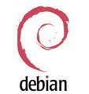
The DISCOVERY Proposal
DIStributed and COoperative framework to manage Virtual EnviRonments autonomously
The LUC OS
A fully distributed IaaS system and not a distributed system of IaaS systemS. We want to/must go further than high level cloud APIs (cross-cutting concerns such as energy/security)
Leverage P2P algorithms and self-* approaches
lots of scientific/technical challenges
Cost of the DISCOVERY network !? partial view of the system !? Impact on the others VMs !?, management of VM images !? Which software abstractions to make the development easier and more reliable (distributed event programming)? How to take into account locality aspects? …
Alice
Internet
backbone
DISCOVERY Network
DISCOVERY Network
9090
9090
9090
Internet Backbone
Notes:
- No real sucess stories (for instance SSI technologies)
- each node runs a discovery agent

Slide 13
The Discovery Initiative Pros/Cons
Pros
Locality (jurisdiction concerns, latency-aware apps, minimize network overhead) Reliability/redundancy (no critical point/location/center) The infrastructure is naturally distributed throughout multiple areas
Lead time to delivery Leverage current PoPs and extend them according to UC demands
Energy footprint (on-going investigations with RENATER)
Bring back part of the revenue to NRENs/Telcos
Cons
Security concerns (in terms of who can access to the PoPs) Operate a fully IaaS in a unified but distributed manner at WAN level
Not suited for all kinds of applications : Large tightly coupled HPC workloads 50 nodes/1000 cores, 200 nodes / 4000 cores (5 racks), so1000 nodes in one PoP does not look realistic …
Peering agreement / economic model between network operators
Notes:
Distributed wikipedia, diaspora, LogNet presentations.
Akamai: un modele proche pour les données (Orange avait un partenaire avec Akamai)

Slide 14
Conclusion
Cloud Computing technology is changing every day
New features, new requirements (IaaS ++ services) One more challenge will be to ensure that such new features/mechanisms can run in a distributed manner.
Distributed Cloud Computing is happening !
Dist. CC workshop (2 editions UCC 2013, SIGCOMM 2014) FOG Computing workshop (collocated with IEEE ICC 2013)
More and more academic papers Decentralizing the Cloud: How Can Small Data Centers Cooperate IEEE P2P 2014…

Slide 15

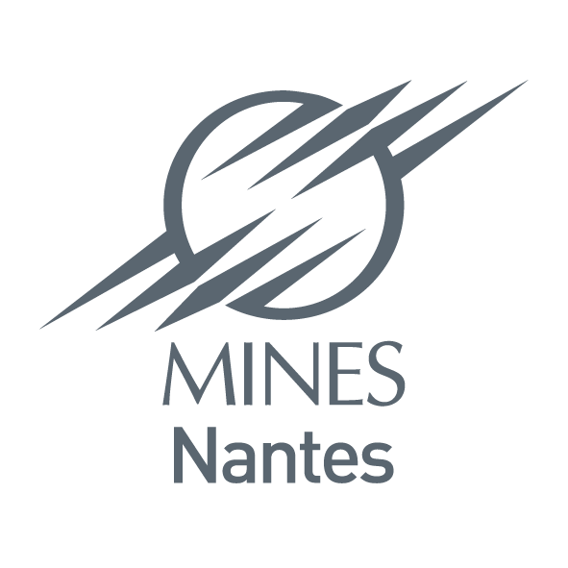
The DISCOVERY Initiative
http://beyondtheclouds.github.io/
Thank you / Questions ?
Several researchers, engineers, stakeholders of important EU institutions and SMEs have been taking part to numerous brainstorming sessions (BSC, CRS4, Unine, EPFL, PSNC, Interoute, Orange Labs, Peerialism, TBS Group, XLAB, …)
http://beyondtheclouds.github.io/ adrien.lebre@inria.fr / jonathan.pastor@inria.fr
Notes:
Distributed wikipedia, diaspora, LogNet presentations.
Mines Nantes et donc indirectement IMT

Slide 16
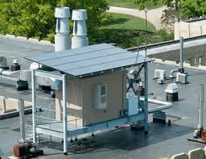
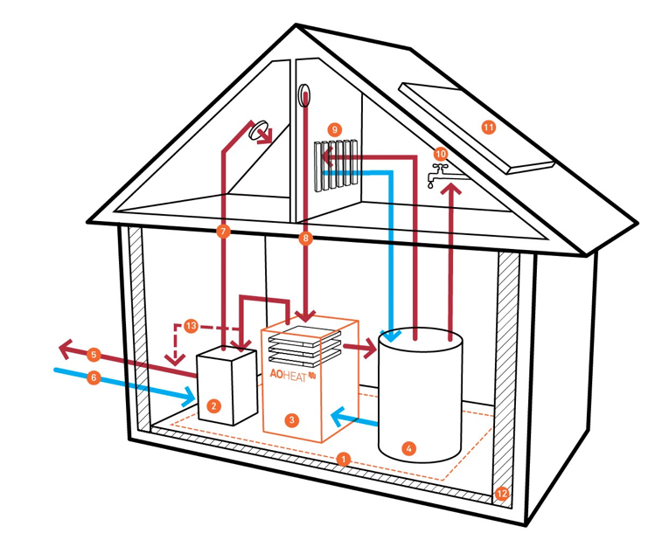
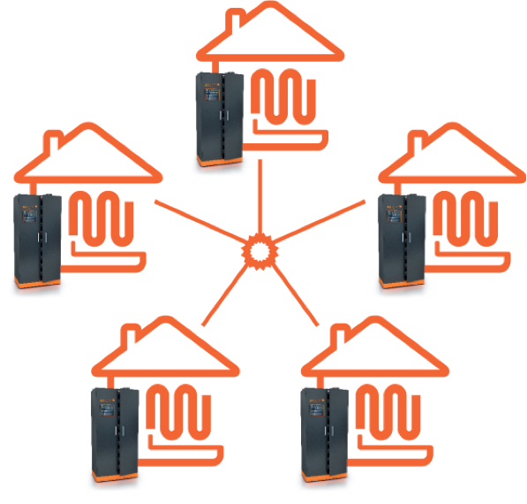
Beyond Discovery !
From sustainable data centers to a new source of energy A promising way to deliver highly efficient and sustainable UC services is to provide UC platforms as close as possible to the end-users and to...
Leverage ‘’green’’ energy (solar, wind turbines...) Transfer the green micro/nano DCs concept to the network PoP Take the advantage of the geographical distribution
Leveraging the data furnaces concept
Deploy UC servers in medium and large institutions and use them as sources of heat inside public buildings such as hospitals or universities
http://parasol.cs.rutgers.edu
https://www.aoterra.de
Notes:
UC platforms should be tightly coupled with any facilities available through the Internet, starting from the cores routers of the backbone, the different network access points and any small and medium-size computing infrastructures that may be provisioned by Internet Service Providers (ISPs), governments and academic institutions.The definition of a complete distributed system in charge of turning a complex and diverse network of resources into a collection ofabstracted computing fa- cilities that is both easy to operate and reliable
Attention exemple de pizza: aucun interet d’un point de vue du restaurant mais interet d’un point de vue impact performance (latence)+energy footprint

Slide 17
Additional slides

Slide 18
Deploying a LUC on top of RENATER
Infrastructure | IT’s Energy | Network Energy | Total | Nb | Overall
Large PoP | 7,6 | 1,3 | 8,9 | 6 | 53,4
Medium PoP | 2,7 | 0,35 | 3,05 | 30 | 91,5
Small PoP | 2,2 | 0,35 | 2,55 | 36 | 91,8
 |  |  |  | Overall | 236,7
Shelter |  | 0,2 |  | 198 | 39,6
 |  |  | Overall with shelters |  | 276,3
Energy consumption of RENATER (estimates in kW)
Infrastructure | Total Energy (IT + Network) |  | Nb | Overall | Nb VMs
1 unit of 100 VMs (10 nodes) | 4 |  | 50 | 200 | 5000
Energy consumption of one 500 nodes cloud (estimates in kW)

Slide 19
Deploying a LUC on top of RENATER
Infrastructure | Nb | Total | Available Energy/PoP | Overall | Overall (after extension) | Nb VMs
Large PoP | 6 | 8,9 | 16 | 53,4 | 149,4 | 2400
Medium PoP | 30 | 3,05 | 4 | 91,5 | 211,5 | 3000
Small PoP | 36 | 2,55 | 0 | 91,8 | 91,8
 |  |  | Overall | 236,7 | 452,7 | 5400
Shelter | 198 | 0,2 |  | 39,6 | 39,6
 |  | Overall with shelters |  | 276,3 | 492,3

Slide 20
Where We Are
Validation of the LUC model (on-going work with RENATER, the French NREN)
From energy/efficiency/economical point of views
On a brick basis (100 VMs) and by considering the cost of the network.
An academic POC for validating the feasibility of major blocks (scheduling of VMs, migration between distinct sites…)
Two PhDs, Two PostDocs
Managing 10K VMs on top of Grid’5000 like normal processes on a laptop.
A POC is nice but can we push this idea further ?
Making a complete system is a huge/non sense effort for researchers ⇒ Revisit OpenStack (on-going/promising work, started 9 months ago)
Notes:
- No real sucess stories (for instance SSI technologies)
- each node runs a discovery agent

Slide 21
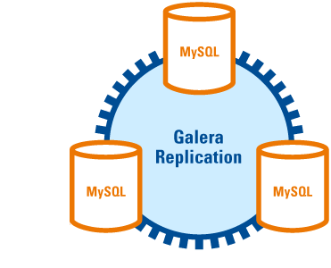
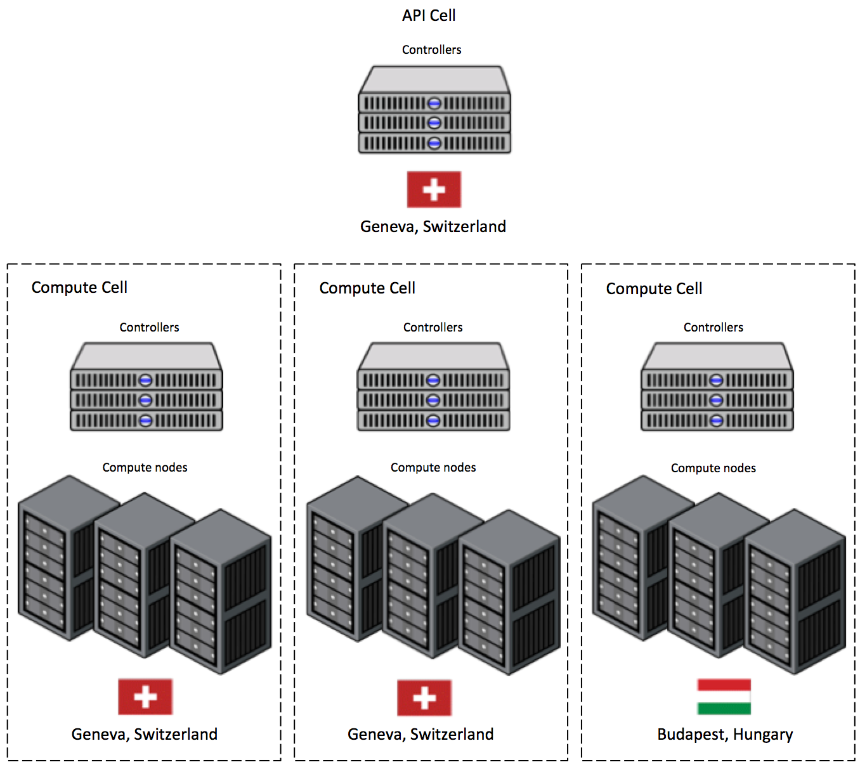
Revisiting OpenStack (on-going)
Few proposals to federate/operate distinct OpenStack DCs
Leveraging Galera ⇒ Scalability issues
Hierarchical approaches
Cells based (CERN: 3 Sites / 50K cores) ⇒ the top cell is a central point
Cascading OpenStack (Huawei, Oct 2014 summit) A more advanced CELLS like approach (nova, neutron,…) ⇒ a unique cascading OpenStack, build on top of the OpenStack API (a system of systems)
You know others ! ? please mail us. We try to maintain a dedicated webpage
Notes:
Distributed wikipedia, diaspora, LogNet presentations.
Akamai: un modele proche pour les données (Orange avait un partenaire avec Akamai)

Slide 22
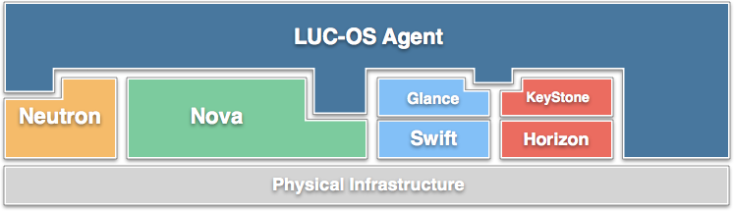
Revisiting OpenStack (on-going)
Our target is to deliver a multi-agent architecture composed of several OpenStack that can natively cooperate (i.e. without specific or priority elements)
Some components should require only minor changes /extensions to fit the Discovery’s requirements (Swift, CephFS).
Others, which have been built on top of centralised components (such as SQL DBs) must be revisited
Identify centralized architecture issues (almost done for Nova, Neutron, Cinder/Glance and Keystone) and propose appropriate mechanisms to distribute them
A Nova POC soon (Nova + RIAK, validation is on-going)
Notes:
Distributed wikipedia, diaspora, LogNet presentations.
Akamai: un modele proche pour les données (Orange avait un partenaire avec Akamai)

